Slide 1
Office Computer Application WEEK EIGHT
Muhammad Unggul Pamenang

Slide 2
Please Do It With MS PowerPoint from 2010 - 2016

Slide 3
SmartArt Graphics
1
MS PowerPoint 2016

Slide 4
Introduction
SmartArt allows you to communicate information with graphics instead of just using text. There are a variety of styles to choose from, which you can use to illustrate different types of ideas.

Slide 5
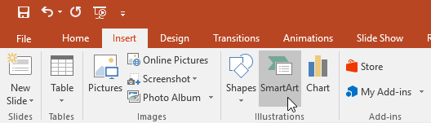
To insert a SmartArt graphic:
Select the slide where you want the SmartArt graphic to appear.
From the Insert tab, select the SmartArt command in the Illustrations group.

Slide 6
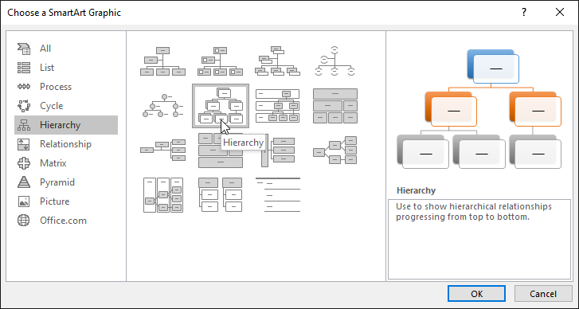
To insert a SmartArt graphic:
A dialog box will appear. Select a category on the left, choose the desired SmartArt graphic, then click OK.

Slide 7
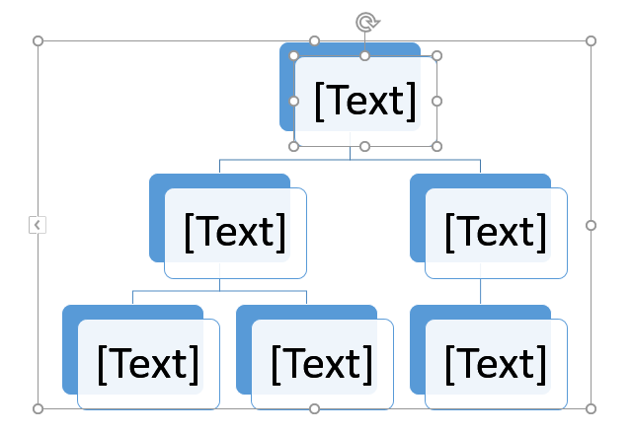
To insert a SmartArt graphic:
The SmartArt graphic will appear on the current slide.

Slide 8
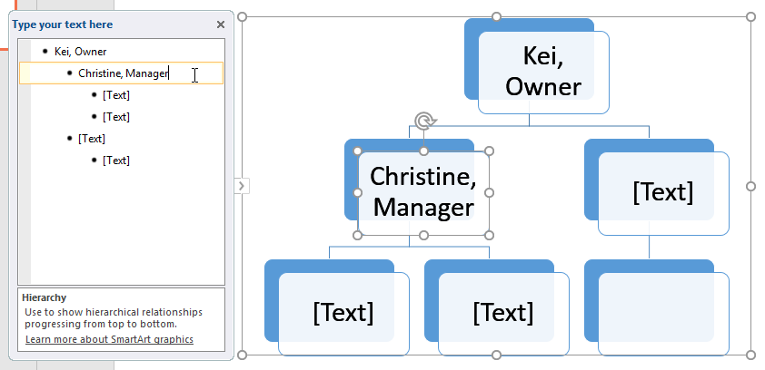
To add text to a SmartArt graphic:
Select the SmartArt graphic. The text pane will appear to the left
Enter text next to each bullet in the text pane. The text will appear in the corresponding shape. It will be resized automatically to fit inside the shape.

Slide 9
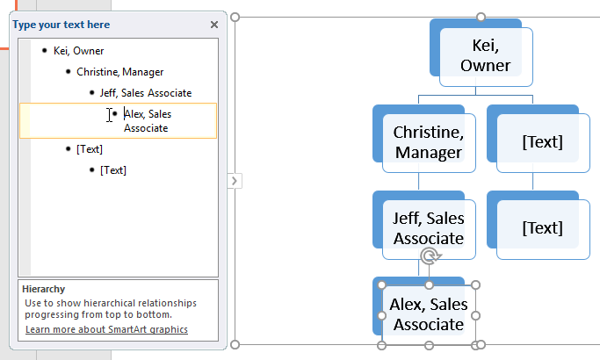
To add text to a SmartArt graphic:
It's easy to add new shapes, change their order, and even delete shapes from your SmartArt graphic. You can do all of this in the text pane, and it's a lot like creating an outline with a multilevel list.
To demote a shape, select the desired bullet, then press the Tab key. The bullet will move to the right, and the shape will move down one level.

Slide 10
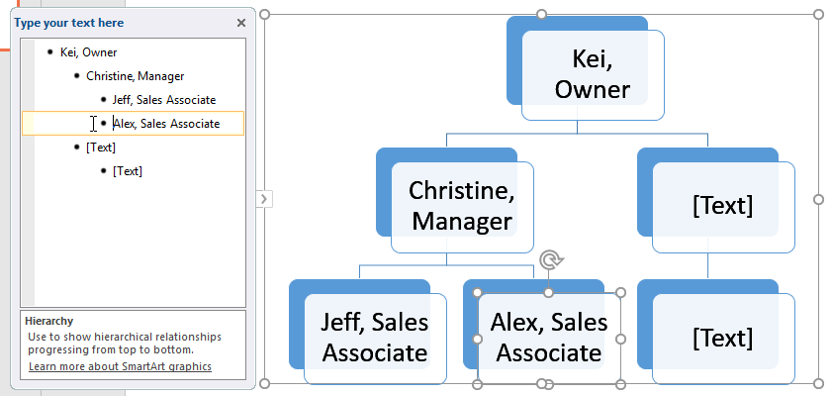
To add text to a SmartArt graphic:
To promote a shape, select the desired bullet, then press the Backspace key (or Shift+Tab). The bullet will move to the left, and the shape will move up one level.

Slide 11
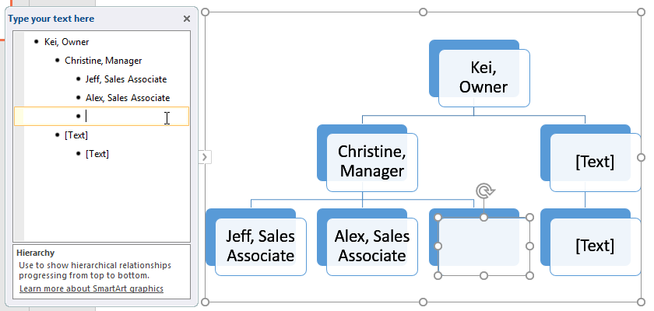
To add text to a SmartArt graphic:
To add a new shape, place the insertion point after the desired bullet, then press Enter. A new bullet will appear in the text pane, and a new shape will appear in the graphic.

Slide 12
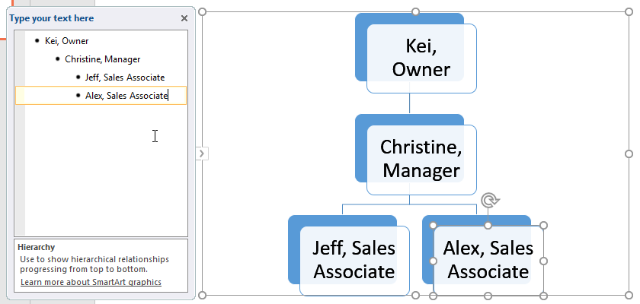
To add text to a SmartArt graphic:
To remove a shape, keep pressing Backspace until the bullet is deleted. The shape will then be removed. In our example, we'll delete all of the shapes without text.

Slide 13
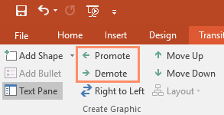
Organizing SmartArt from the Design tab
If you'd prefer not to use the text pane to organize your SmartArt, you can use the commands on the Design tab in the Create Graphic group. Just select the shape you want to modify, then choose the desired command.
Promote and Demote: Use these commands to move a shape up or down between levels.

Slide 14
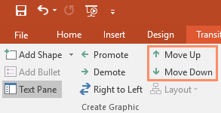
Organizing SmartArt from the Design tab
Move Up and Move Down: Use these commands to change the order of shapes on the same level.

Slide 15
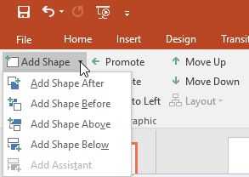
Organizing SmartArt from the Design tab
Add Shape: Use this command to add a new shape to your graphic. You can also click the drop-down arrow for more exact placement options.

Slide 16
Customizing SmartArt
After inserting SmartArt, there are several things you might want to change about its appearance. Whenever you select a SmartArt graphic, the Design and Format tabs will appear on the right side of the Ribbon. From there, it's easy to edit the style and layout of a SmartArt graphic.

Slide 17
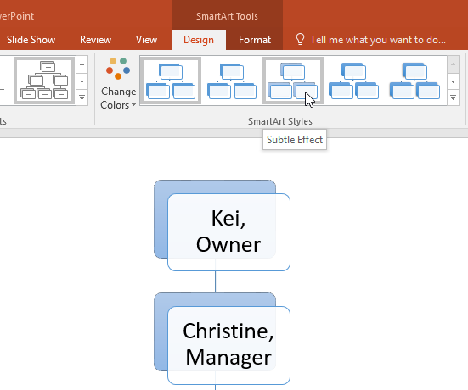
Customizing SmartArt
There are several SmartArt styles, which allow you to quickly modify the look and feel of your SmartArt. To change the style, select the desired style from the SmartArt styles group.

Slide 18
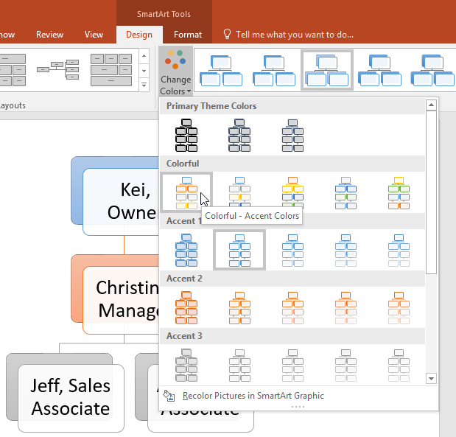
Customizing SmartArt
You have a variety of color schemes to use with SmartArt. To change the colors, click the Change Colors command and choose the desired option from the drop-down menu.

Slide 19
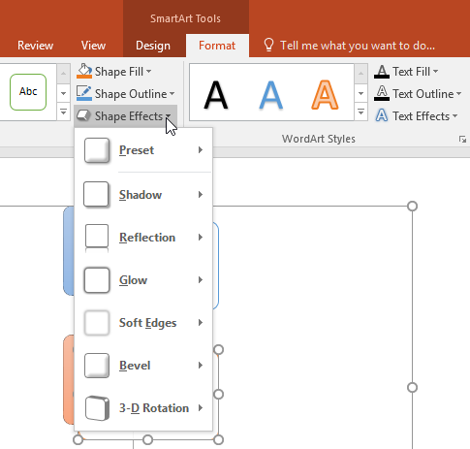
Customizing SmartArt
You can also customize each shape independently. Just select any shape in the graphic, then choose the desired option from the Format tab.

Slide 20
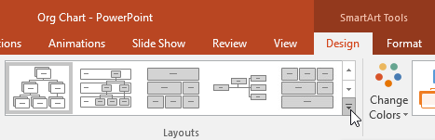
Customizing SmartArt
If you don't like the way your information is organized within a SmartArt graphic, you can always change its layout to better fit your content.
From the Design tab, click the More drop-down arrow in the Layouts group.

Slide 21
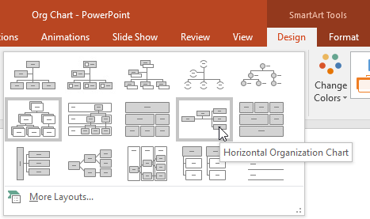
Customizing SmartArt
Choose the desired layout, or click More Layouts to see even more options.

Slide 22
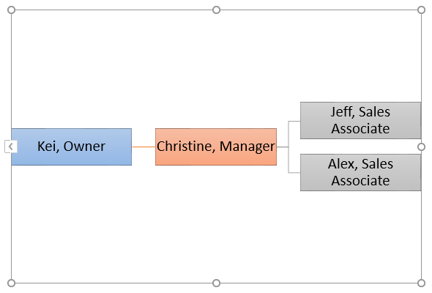
Customizing SmartArt
The selected layout will appear.

Slide 23
JOBSHEET
Continue working

Slide 24
THANKS!

